Slide 1
Engineering concepts of cities and buildings
Certification LEED, BREEAM and WELL
BIM – information modeling
Overview of the certification system EDGE for buildings
Ilya Zavaleev
March 18, 2021

Slide 2
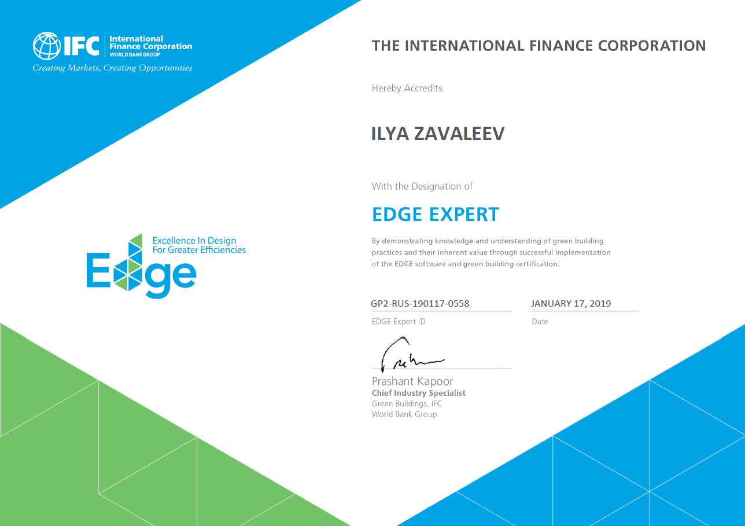

Slide 3
What is Green Building?
What is "EDGE"?
ATTRIBUTES OF A GREEN BUILDING
Saving water
Reduced carbon footprint
Energy saving

Slide 4
Overview of the EDGE Green Building standard.
IFC - International Financial Corporation - a World Bank Group company
The EDGE standard was developed by IFC in order to promote and simplify green building practices in developing countries.
The purpose of the EDGE standard is to provide a simple, inexpensive and understandable building planning and certification tool for developers who want to apply green technologies in their projects, but do not have large resources to use complex systems. Using the EDGE toolkit, a developer can quickly evaluate design solutions in terms of their cost, payback period and effect on ecology and energy efficiency using a free and simple online tool.
HPB-S.com ® 2017

Slide 5
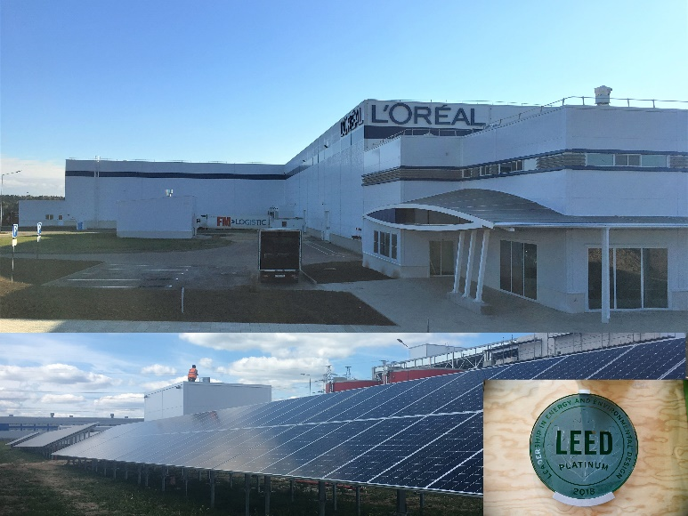
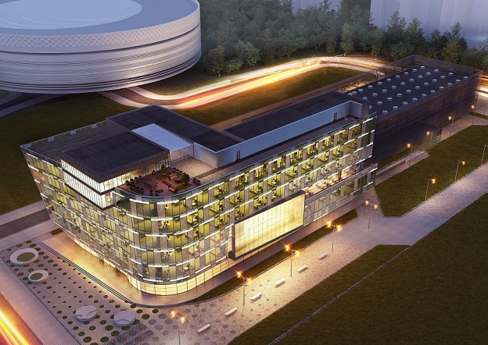
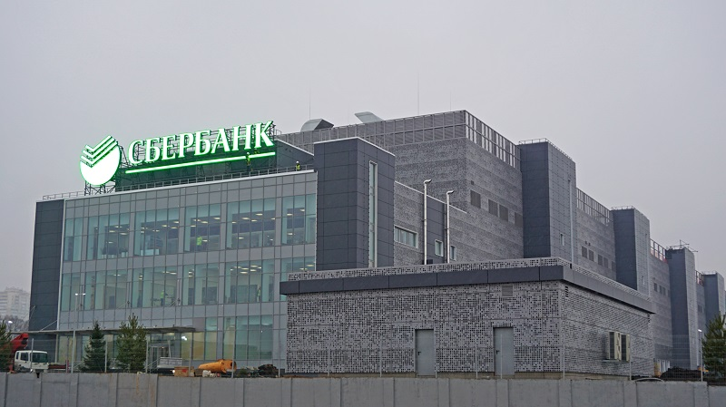
The online tool provides a catalog of ready-made engineering solutions and can estimate approximately the effectiveness of their implementation for the following types of buildings:
Housing
Hotels
Commercial buildings
Offices
Hospitals
Educational institutions
Warehouses and light industry

Slide 6
EDGE rating systems
Certification levels
LEVEL 1: EDGE Certified – 20% in each category
LEVEL 2: EDGE Advanced – 40% in each category
LEVEL 3: Zero Carbon – 40% energy efficiency + 100% energy must be formed BY renewable sources, available after basic certification, recertification every 4 years.
HPBS©2017

Slide 7
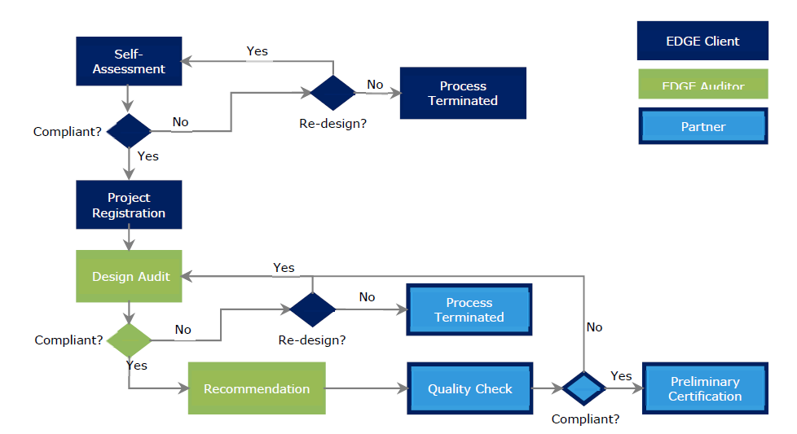
EDGE rating systems
Certification process
HPBS©2017

Slide 8
EDGE rating systems
Certification process
HPBS©2017

Slide 9
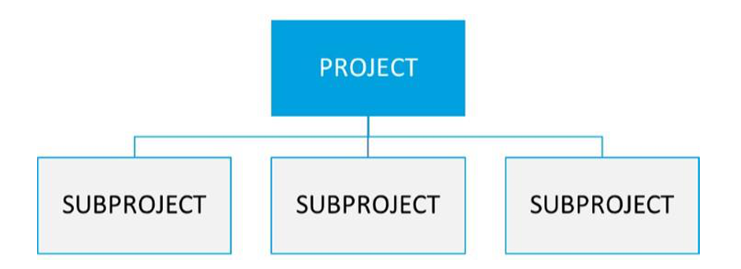
EDGE rating systems
Real estate Portfolio certification
Less costs
Accelerated document submission process
Extended technical support
HPBS©2017

Slide 10
EDGE rating systems
Rates
Registration 300 USD – building
Certification 0.27 USD/m2, but not less than 2250 USD (2,400)
Expert support
Audit:
- Designing
- Construction
Individual discount for the portfolio
HPBS©2017

Slide 11
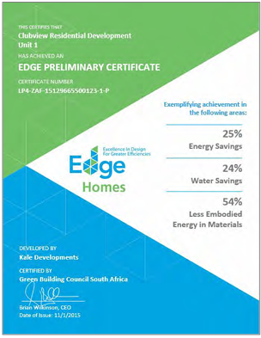
Stages of implementation of the new building
Concept | Project | Purchases | Construction | Commissioning | Exploitation
Development of special technical conditions
Project registration
Implementation of requirements
Preparation of specifications and technical tasks
Examination of design solutions (audit)
Compliance with construction requirements
Examination of the completed object
Issuing a certificate for an object
HPBS® 2019

Slide 12
Example calculation of the cost of services for a complex of buildings (preliminary)
No | SERVICES OF HPBS | Stage cost, USD
1 | Development of a technical certification strategy. | 10 000
2 | Design support, including: engineering and technical consulting on energy efficiency, water conservation and analysis of the life cycle of materials. | 24 000
3 | Preparation of audit documentation at the design stage | 8 000
4 | Construction support, including: engineering and technical consulting on the choice of materials, equipment and organization of construction methods | 24 000
5 | Preparation of documentation for audit at the construction stage | 8 000
 | Total cost of services, USD excluding VAT | 74 000
The cost of the certifying authority
 | Project registration and certification | 30 000
Стоимость аудита
 | Audit at the design stage | 20 000
 | Audit at the construction stage | 15 000
Total: up to 139 000 USD
HPBS©2017

Slide 13
Contact information
Create a favorable environment for people, nature and business
LLC "HPBSolution«
Moscow, Party lane, 1, bldg. 46, office No. 513
Тел. +7 (495) 231 09 04
+ 31 6 1560 6148
www.hpb-s.com info@hpb-s.com
HPBS

